Slide 1
Diagnosing depression in social media
Jeffrey Ng

Slide 2
Project overview
Scraped data over 120,000 tweets from social media site Twitter
Used LIWC lexicon to gauge emotion in text (sadness)
Handled class imbalance of depressed and not depressed
NLP on social media text
Trained logistic regression model with 85% accuracy depression of individual based on social media post
Built flask front end to capture the user’s feelings that day. A basic ‘type your feelings’ text box and diagnose for depression using model.

Slide 3
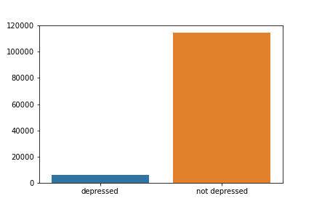
Data (class Imbalance - binary classification)
Upsampled minority and downsampled majority to even out the classes
class_weight= ‘balanced’
114580 not depressed, 6188 depressed

Slide 4
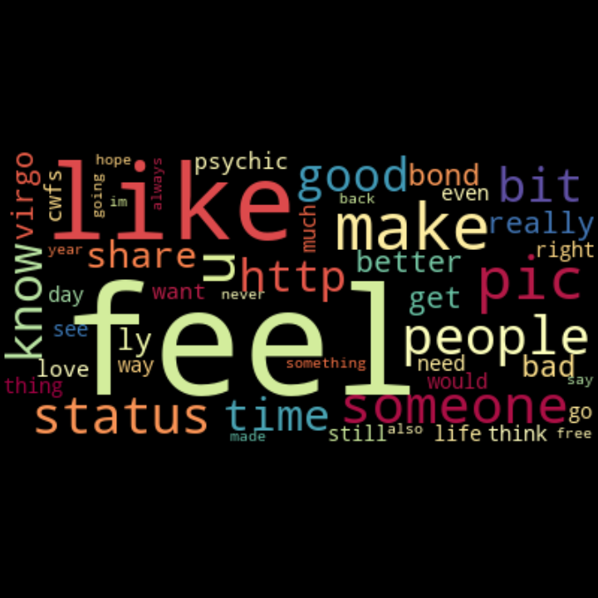
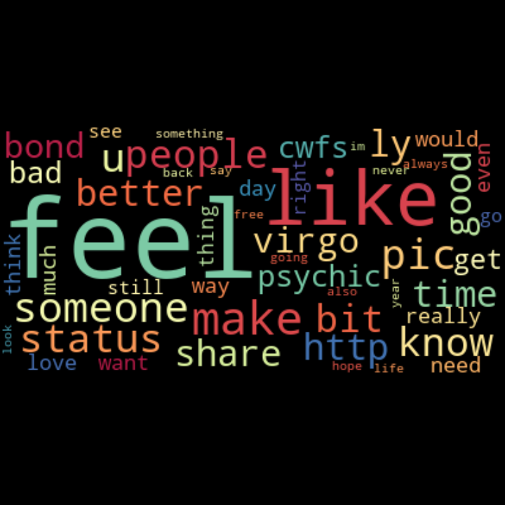
Word clouds
Not Depressed Depressed
Not Depressed

Slide 5
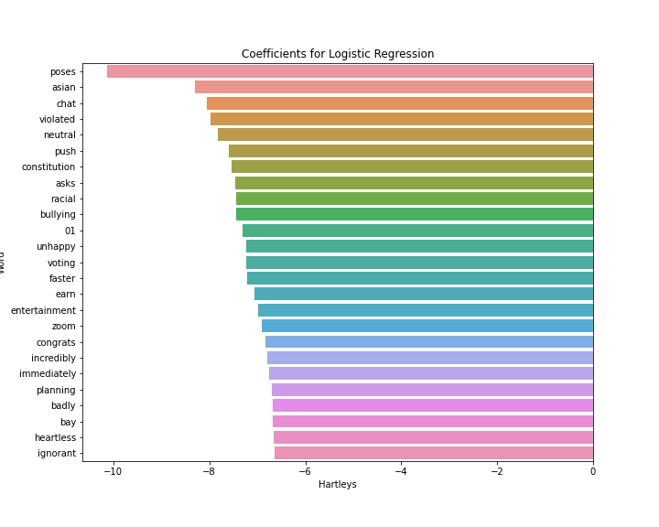
Happiest words indicative of not depressed (log reg)

Slide 6
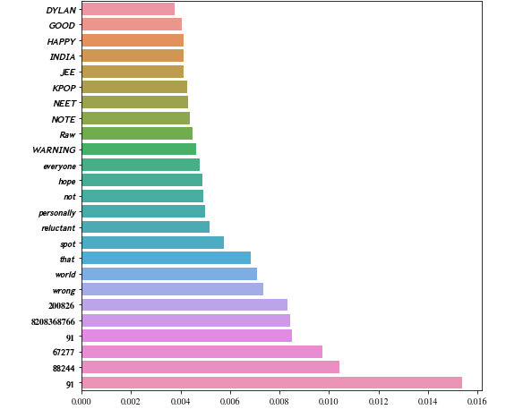
Most important words that predicted the classes

Slide 7
modeling
Logistic Regression *
Accuracy, F1 = 85% *
Random Forest
Accuracy, F1 = 62%
Naive-Bayes
Accuracy, F1 = 79%

Slide 8
Flask front-end

Slide 9
conclusion
85% f1, acc for logistic regression (best model)
Use facebook posts for better training data on LIWC lexicon
Model will be used in Flask front-end
Consult physician about sadness for extended time to diagnose depression
Model cannot distinguish light/heavy (degree) of depression, but detecting early light depression is beneficial

Slide 10
The end.
Thank you!

